Slide 1
Android Application Structure

Slide 2
Contents
Android project structure
Build the first application
Android application components

Slide 3
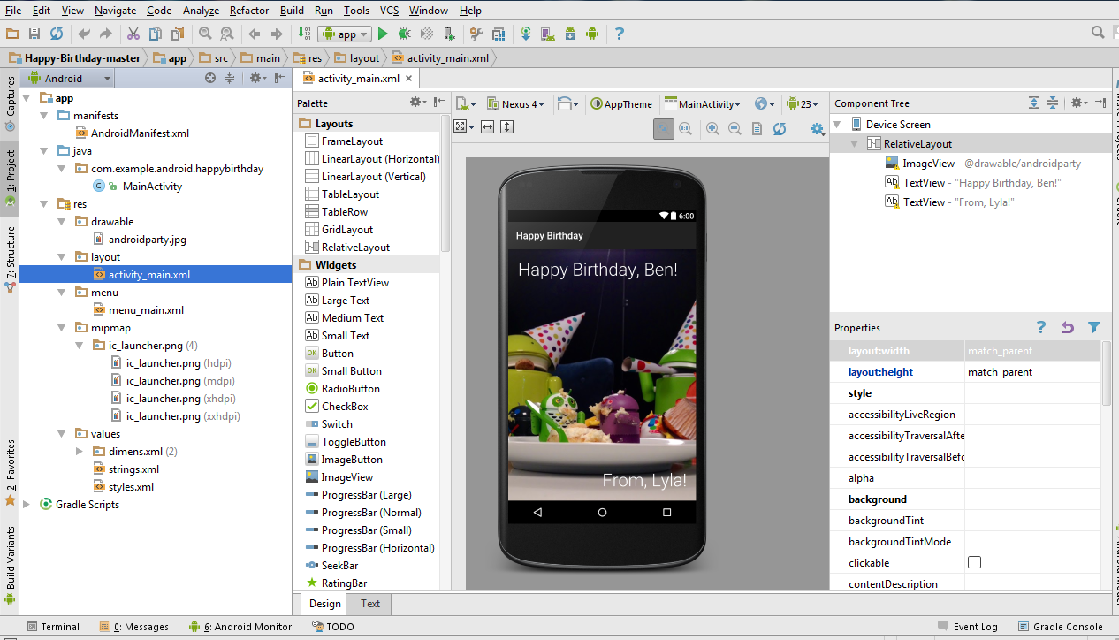
Android project structure

Slide 4
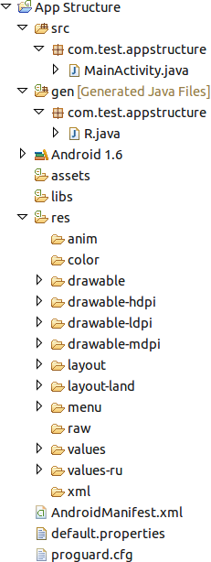
Android project structure
Contains your stub Activity file, which is stored at src/your/package/ActivityName.java.
All other source code files go here as well.

Slide 5
Android project structure
Contains the Java files generated by ADT, such as your R.java file and interfaces created from AIDL files.

Slide 6
Android project structure
You can use it to store raw asset files. Files that you save here are compiled into an .apk file as-is, and the original filename is preserved.

Slide 7
Android project structure
Contains private libraries

Slide 8
Android project structure
Contains application resources, such as drawable files, layout files, and string values

Slide 9
Android project structure
For XML files that are compiled into animation objects

Slide 10
Android project structure
For bitmap files (PNG, JPEG, or GIF), 9-Patch image files, and XML files that describe Drawable shapes or a Drawable objects that contain multiple states (normal, pressed, or focused)

Slide 11
Android project structure
XML files that are compiled into screen layouts (or part of a screen)

Slide 12
Android project structure
For XML files that define application menus

Slide 13
Android project structure
For arbitrary raw asset files. Saving asset files here instead of in the assets/ directory only differs in the way that you access them.

Slide 14
Android project structure
For XML files that are compiled into many kinds of resource

Slide 15
Android project structure
For miscellaneous XML files that configure application components.

Slide 16
Android project structure
The control file that describes the nature of the application and each of its components.

Slide 17
Android project structure
This file contains project settings, such as the build target. This files is integral to the project, as such, it should be maintained in a Source Revision Control system. Do not edit the file manually.

Slide 18
Android project structure
This file defines how ProGuard optimizes and obfuscates your code

Slide 19
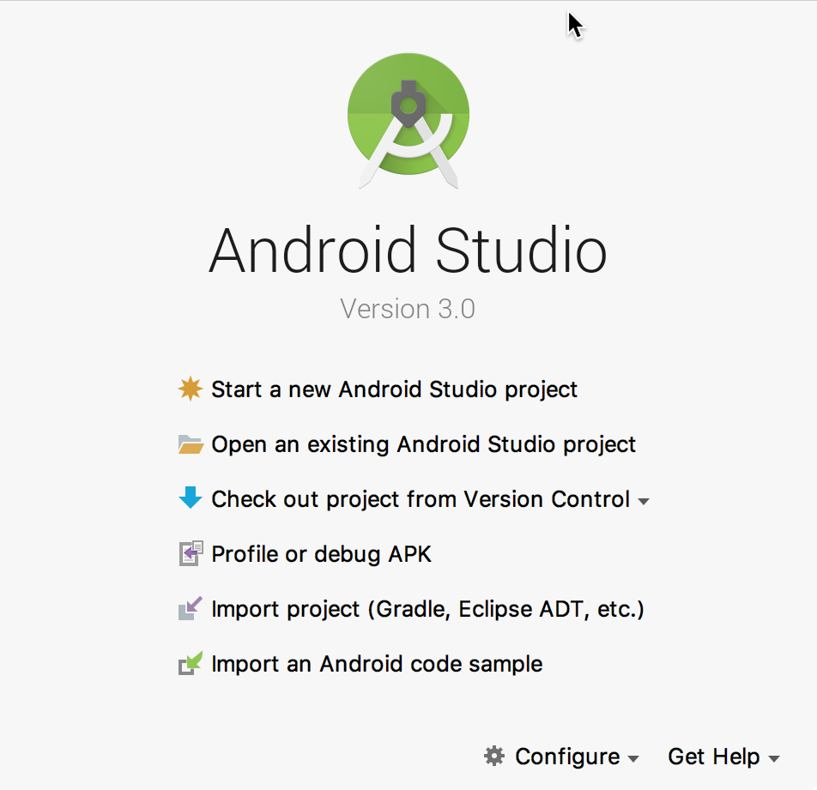

Build the first application
Start Android Studio

Slide 20
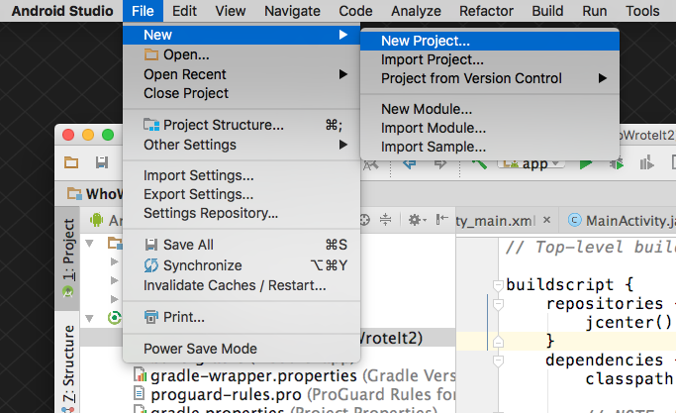
Create a project inside Android Studio

Slide 21
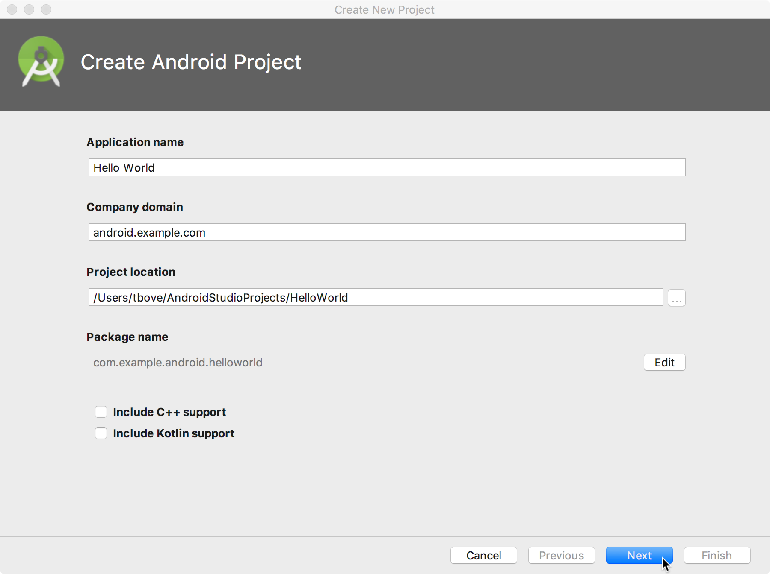
Name your app

Slide 22
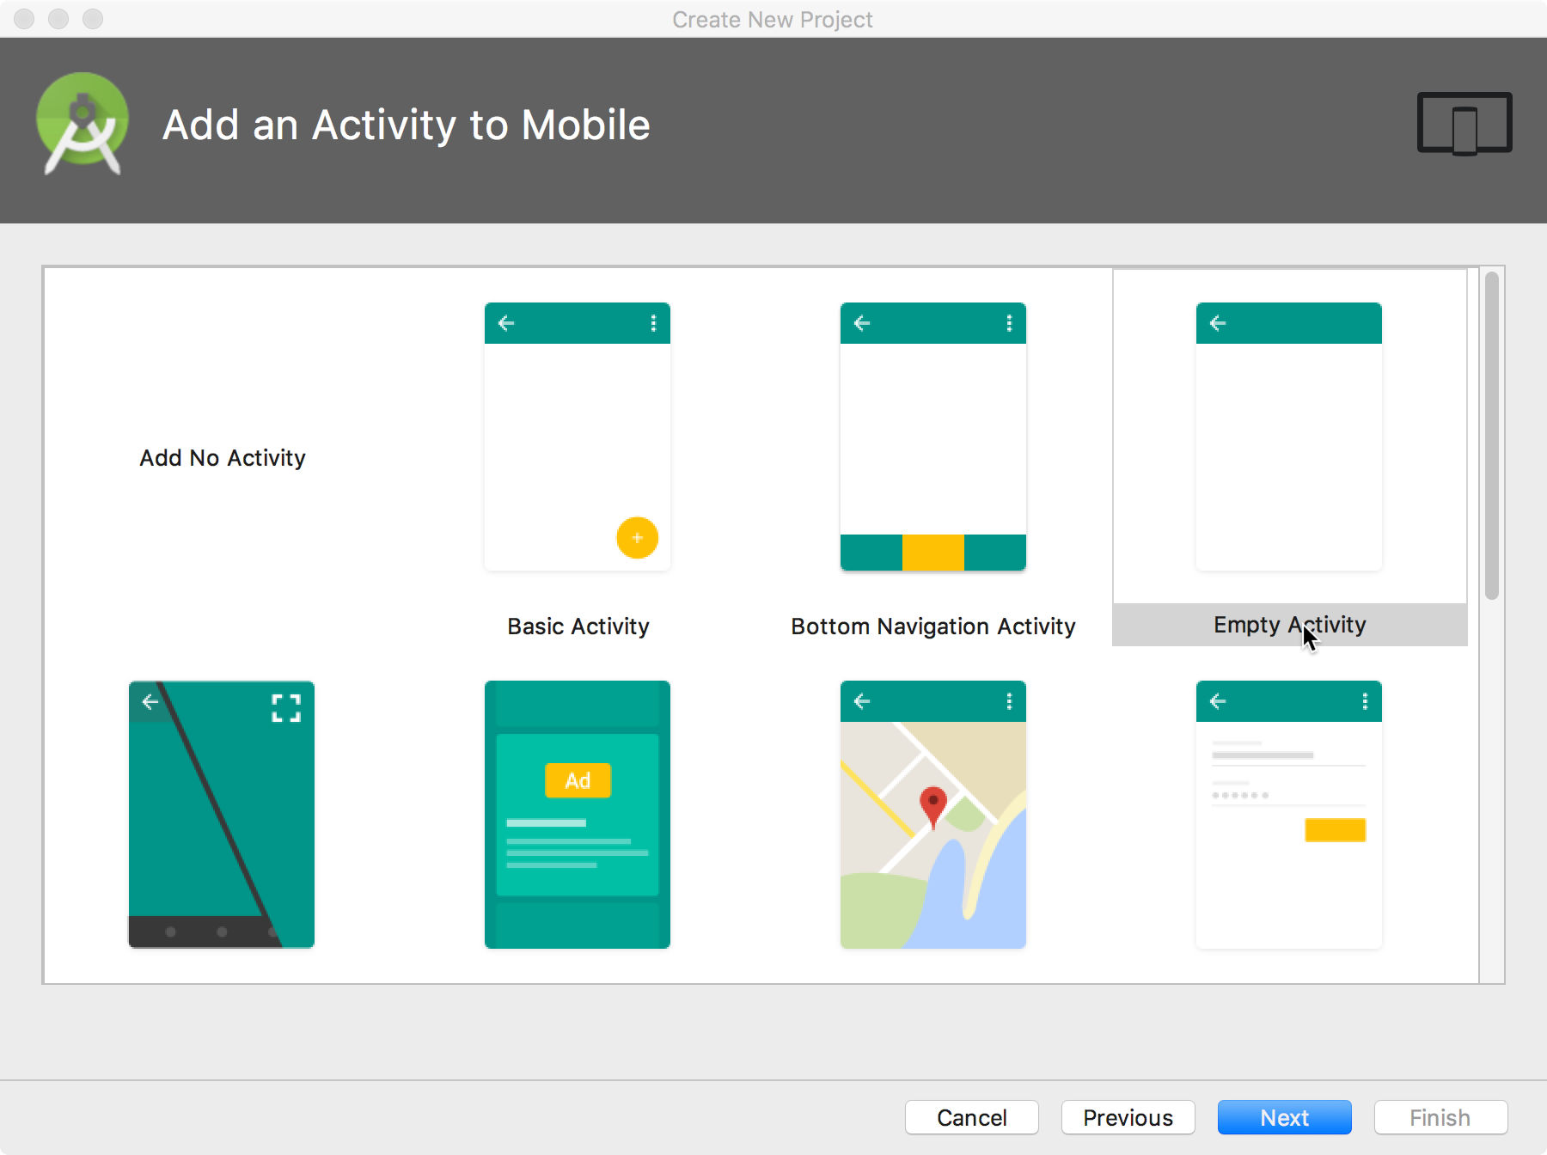
Pick activity template
Choose templates for common activities, such as maps or navigation drawers.
Pick Empty Activity or Basic Activity for simple and custom activities.

Slide 23
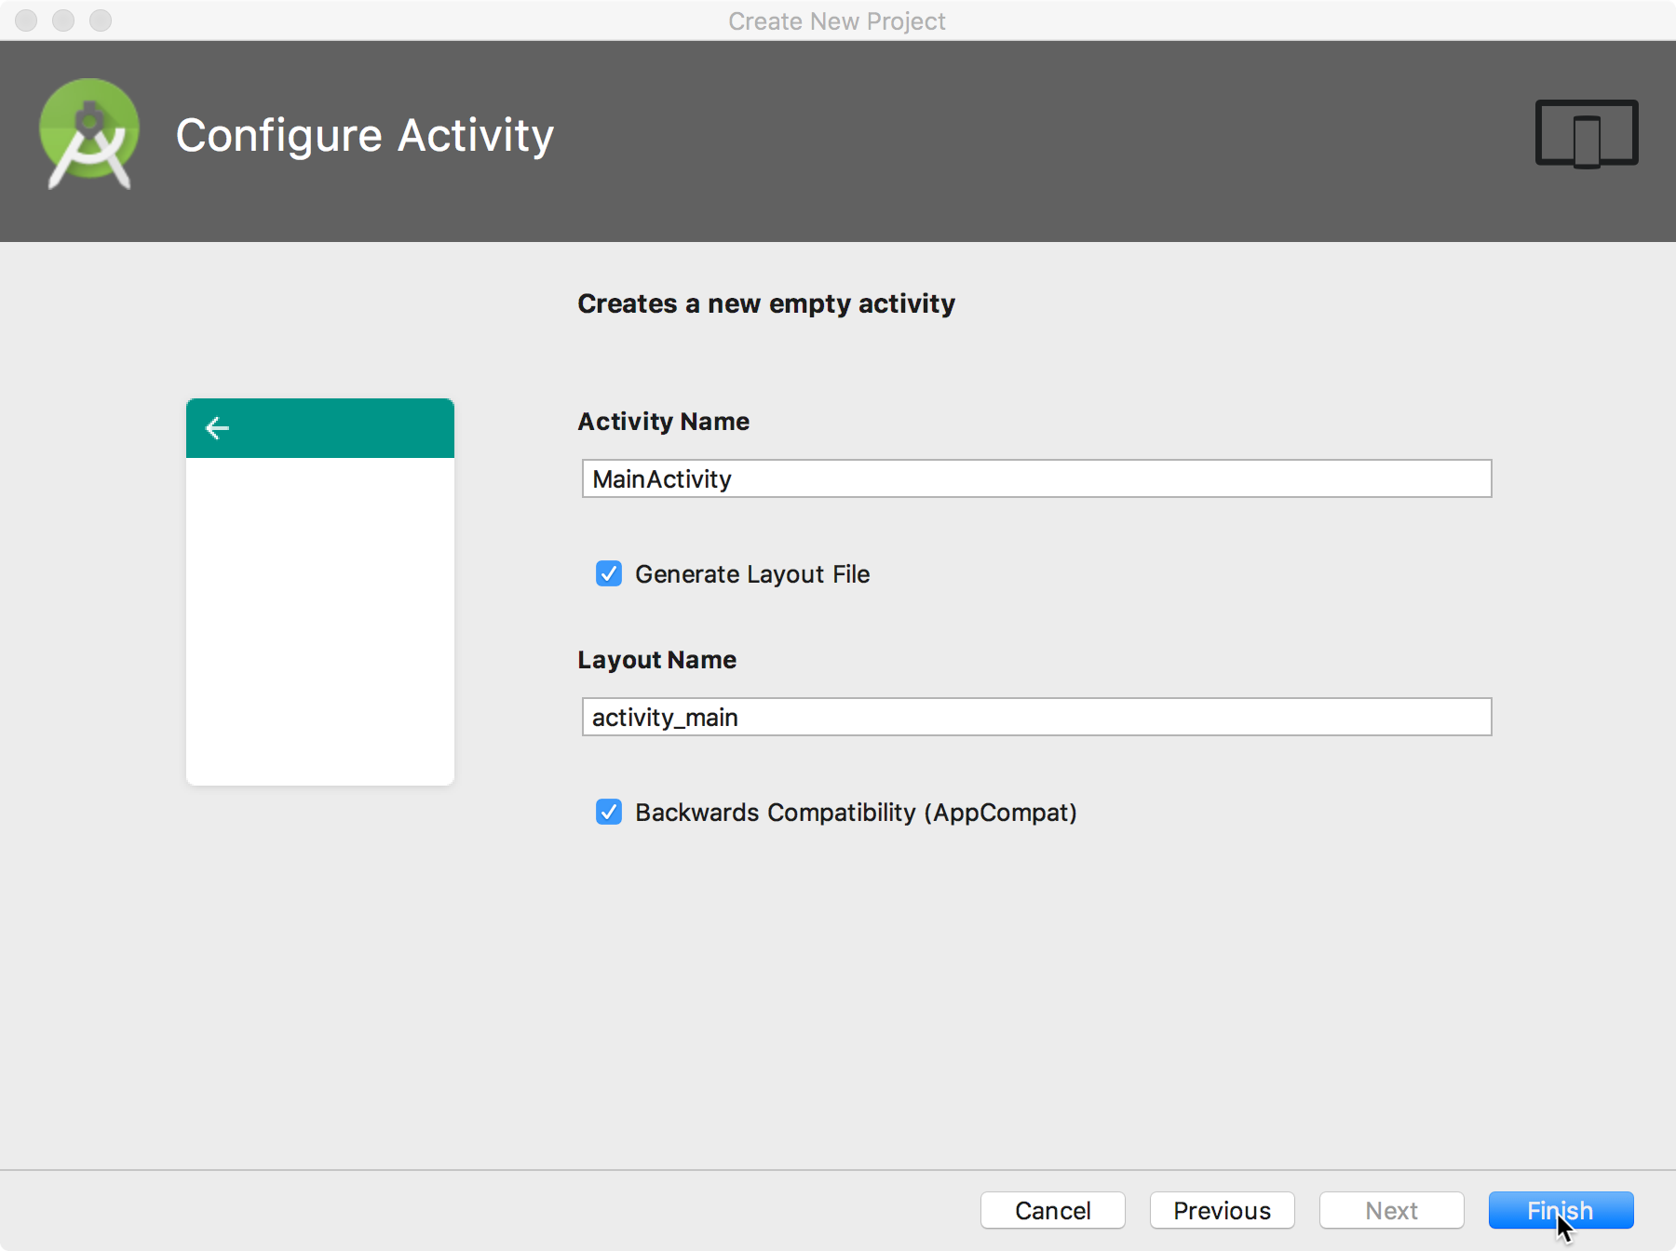
Name your activity
Good practice:
Name main activity MainActivity
Name layout activity_main
Use AppCompat
Generating layout file is convenient

Slide 24
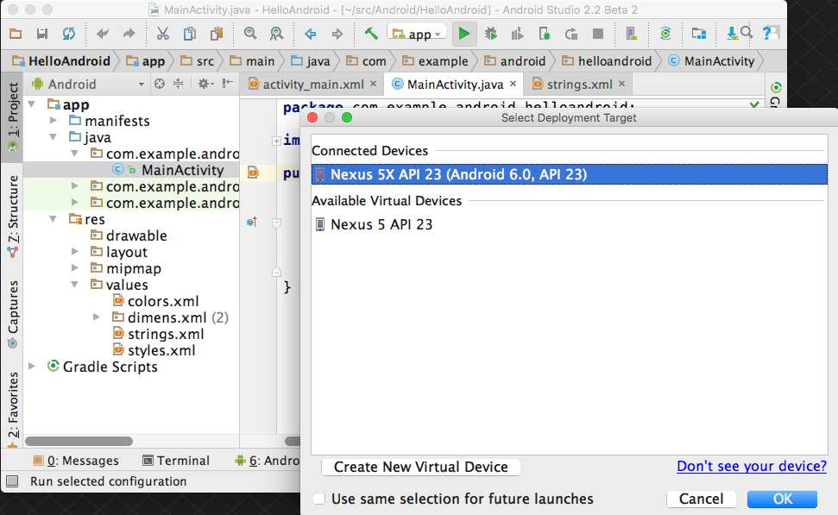
Run your app
Run
2. Select virtual or physical device
3. OK

Slide 25
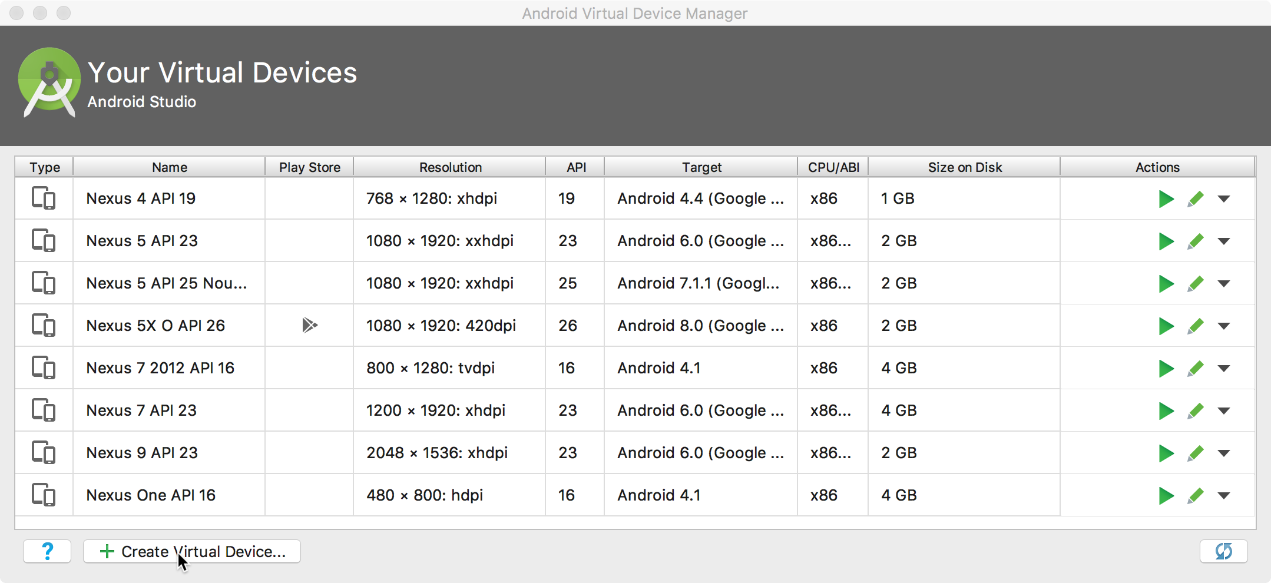
Create a virtual device
Use emulators to test app on different versions of Android and form factors.
Tools > Android > AVD Manager

Slide 26
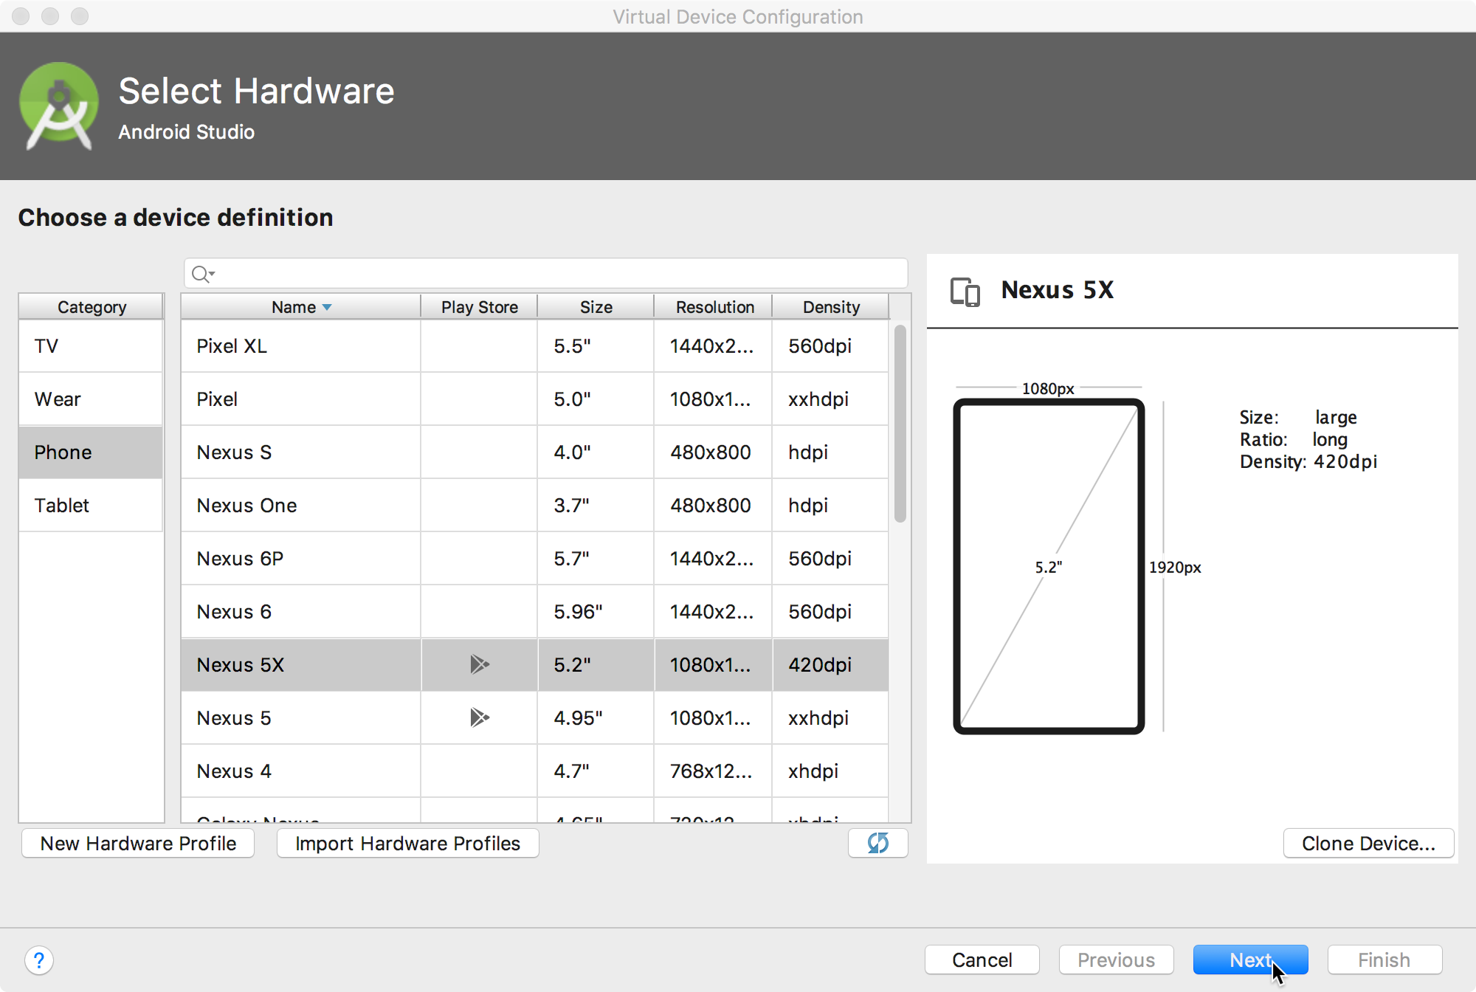
Configure virtual device
Choose hardware
Select Android version
Finalize

Slide 27
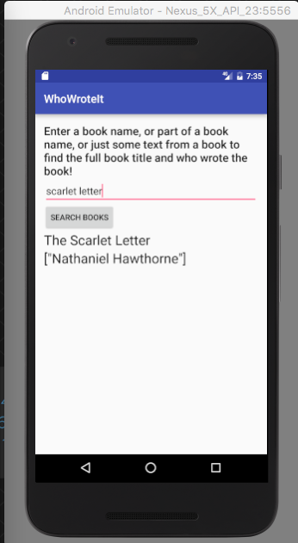
Run on a virtual device

Slide 28
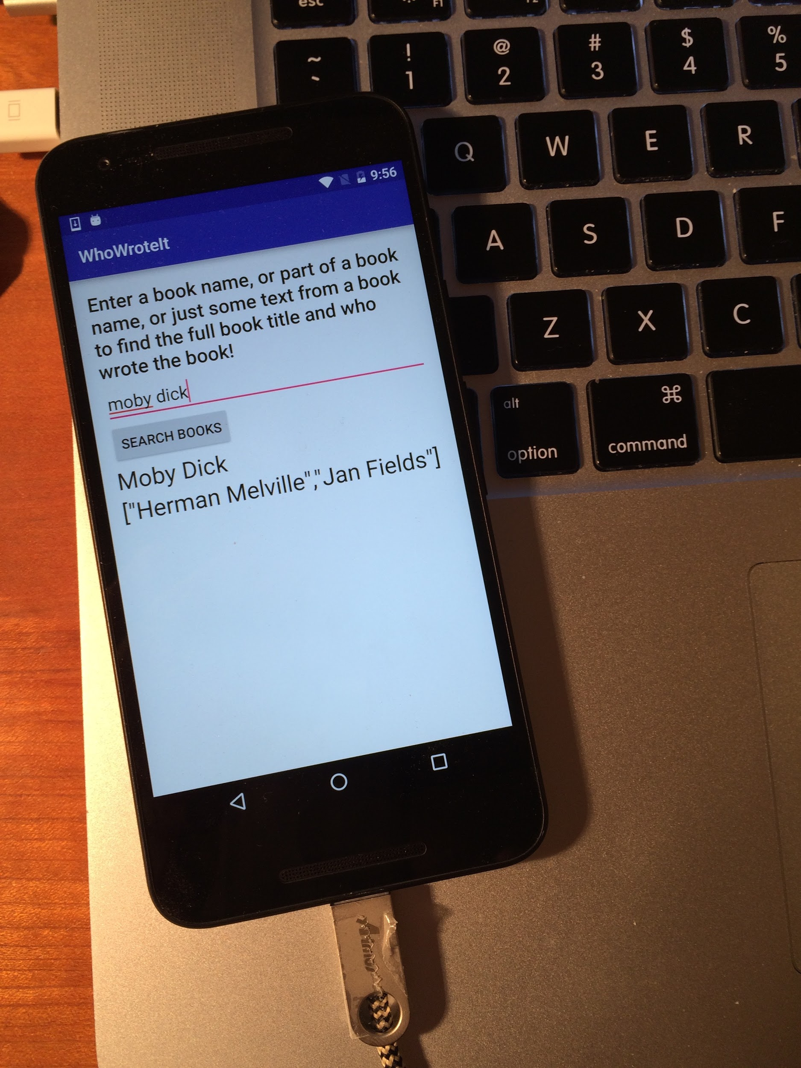
Run on a physical device
Turn on Developer Options:
Settings > About phone
Tap Build number seven times
Turn on USB Debugging
Settings > Developer Options > USB Debugging
Connect phone to computer with cable

Slide 29
Android Application Components
Activities – visual user interface focused on a single thing a user can do
Services – no visual interface – they run in the background
Broadcast Receivers – receive and react to broadcast announcements
Content Providers – allow data exchange between applications

Slide 30
Activities
Basic component of most applications
Most applications have several activities that start each other as needed
Each is implemented as a subclass of the base Activity class

Slide 31
Activities – The View
Each activity has a default window to draw in (although it may prompt for dialogs or notifications)
The content of the window is a view or a group of views (derived from View or View Group)
Example of views: buttons, text fields, scroll bars, menu items, check boxes, etc.
View(Group) made visible via Activity.setContentView() method.

Slide 32
Services
Does not have a visual interface
Runs in the background indefinitely
Examples
Network Downloads
Playing Music
TCP/UDP Server
You can bind to an existing service and control its operation

Slide 33
Broadcast Receivers
Receive and react to broadcast announcements
Extend the BroadcastReceiver class
Examples of broadcasts:
Low battery, power connected, shutdown, time zone changed, etc.
Other applications can initiate broadcasts

Slide 34
Content Providers
Makes some of the application data available to other applications
It’s the only way to transfer data between applications in Android (no shared files, shared memory, pipes, etc.)
Extends the ContentProvider class
Other applications use a ContentResolver object to access the data provided via a ContentProvider object

Slide 35
Classwork
Build and Run a Hello app

Slide 36
References
https://google-developer-training.github.io/android-developer-fundamentals-course-concepts-v2/

